Slide 1
TRACTION TECHNIQUES
LECTURE NOTES
PREPARED BY J. OFULLAH

Slide 2
CONTENTS
The history of traction
Types of traction by method of application
Types of traction by mechanism
Specific traction methods
Cervical traction
Halter traction
Olecranon pin traction
Bryant’s traction
90:90 traction
Perkins traction
Russell traction
Metacarpal pin traction
Calcaneal traction
Distal tibial traction
Distal femoral traction
Proximal tibial traction
Bucks traction
Knots used in tying traction cords
Exercises for the upper limbs
Exercises for the lower limbs

Slide 3
DEFINITION AND GENERAL INDICATIONS
DEFINITION:
The application of a pulling force to a part of the body
INDICATIONS:
To reduce the fracture or dislocation
To maintain the reduction
To correct the deformity
To reduce the muscle spasm

Slide 4
HISTORY OF TRACTION
Traction was used during the American civil war
Skeletal traction by a pin through bone was introduced by Kirschner and Steinman
Guy de Chauliac introduced isotonic traction for fracture femur
Percival Pott – fractured limbs should be placed in position in which muscles are relaxed
Thomas Bryant introduced Bryants traction for fracture shaft femur in children
Thomas splint used for fixed traction
Malgaigne introduced first effective traction which grasped the bone by Malgaigne hooks
Fritz Steinman introduced skeletal traction by pins through the femoral condyles
Lorenz Bohler devised the Bohlers stirrup to assist skeletal traction

Slide 5
TYPES OF TRACTION BY METHOD
Manual
- The hands are used to exert a pulling force to the bone which is to be realigned before immobilization in a cast
Skin
- The traction force applied over a large area of skin (adhesive and non-adhesive types)
Skeletal
- Applied directly to the bone either by pin or wire through the bone (e.g. Steinman pin or Kirschner wire)

Slide 6
TYPE OF TRACTION BY MECHANISM
Fixed traction
Effected by applying a force against a fixed point on the body.
Sliding traction
Weight of body acts as a counter-traction usually made more effective by elevating foot of bed or in other circumstances the head of the bed.

Slide 7
COMPLICATIONS OF TRACTION
Complications can be subdivided into those evident when skin traction is used and those evident in case of skeletal traction
Skin traction complications:
- Ulceration of poorly padded bony prominences
- Decubitus ulcers or bed sores
- Malunion and Non-union
Skeletal traction complications:
- Infection to bone
- Distraction at fracture site due to overtraction
- Ligament damage if traction force is large and prolonged around joint areas
- Damage to epiphysis if used in children
- Depressed scars
- Uneven pull at ends of pin and difficulty in rotation of limb if pin placement is incorrect
- Nerve damage when care is not taken in pin insertion
- Damage to blood vessels

Slide 8
SPECIFIC TRACTION METHODS
Cervical traction
Halter traction
Bryants traction
Russels traction
Bucks traction
Fixed traction
Perkins traction
Calcaneal traction
Pelvic traction
Hammock traction
Dunlop traction
90-90 traction
Olecranon traction
Metacarpal pin traction
Distal tibial traction proximal tibial traction

Slide 9
MANUAL TRACTION
Hands are used to exert a pulling force in order to realign the fractured fragments then immobilization is effected by use of splints or plaster casts
Manual traction can also be used prior to application of skin or skeletal traction

Slide 10
SKIN TRACTION
Skin-Trac Traction Strips are applied directly to the skin.
Traction boots for leg traction and pelvic belts for spinal disorders can also be classified under this category.
Indications for skin traction are fractures in children and in adults where amount of pulling force required is not much and for a relatively short period.

Slide 11
SKELETAL TRACTION
Skeletal traction applies the tractive force directly to the bone using pins, wires, screws and, in the case of cervical traction, using tongs or halos applied directly to the skull.
Skeletal traction allows the use of up to 20kg of force for as long as three to four months, if necessary.
It exerts a longitudinal pull and also controls rotation.
Advantageous to use skeletal traction for unstable and multi-fragmented fractures

Slide 12
CERVICAL TRACTION
Indications :
Used to treat the unstable spine
Equipment :
Gardner tongs
Crutchfield tongs
Halo ring traction
Baseline weight for C1 is 2.3 kilograms up to a maximum of 4.5kgs

Slide 13
Guideline for Weights used in Cervical traction
C1 – 2.3Kg to 4.5Kg
C2 – 3.0Kg to 5.5Kg
C3 – 3.6Kg to 6.7Kg
C4 – 6.7Kg to 9.0Kg
C5 – 9.0Kg to 11.3Kg
C6 – 9.0Kg to13.5Kg
C7 – 11.3Kg to 15.8Kg

Slide 14
Gardner tong screws are applied at intersection point 2cms behind the pinna and 2cms above the pinna in line with the mastoid process
Baseline weight for C1 injury is 2kg aproximately 2kg per level of vertebra is added when dealing with cervical spine injuries upto about 16kg
Crutchfield tongs are placed similarly to Gardner tongs though skin incised and cortex must be drilled to place it
Halo ring traction used for c-spine and t-spine fractures and applied under GA; controls direction of force; traction maintained even when patient out of bed

Slide 15
Halo ring pins are four 2 anterior while 2 are placed posteriorly.
The anterior pins are placed in the frontal groove superior and lateral to the supra-orbital ridge.
The posterior pins are placed posterior and superior to the external ear.
Pins are tightened with a screwdriver.
The traction pull should be more anterior for extension and more posterior for flexion.
The same weights as per skull tongs are used.

Slide 16
GENERAL RULES FOR APPLYING SKELETAL TRACTION
Applied under anaesthesia, usually local anaesthetic is used
Aseptic precautions must be employed
Look for landmarks that will help you to avoid traumatising the vital nerves and vessels
The pin should be at right angles to the limb and parallel to the ground

Slide 17
AVOID TIGHT WRAPPING AT THESE PRESSURE POINTS ON APPLICATION OF SKIN TRACTION
Styloid Process of Ulna
Lateral Epicondyle
Deltoid Tuberosity
Medial Epicondyle
Lateral and Medial Malleolar areas
Head of Fibular
Tuberosity of Tibia
Achilles Tendon
Dorsal Prominence of feet

Slide 18
HEAD HALTER TRACTION
A simple type of cervical traction used to manage neck pains the weight should not exceed 3kg in the initial phases
The traction can be used for just a few hours at a time
Outpatient head halter traction can also be used it hooks over the door and may be used for 30minutes per day with a weight of about 5kg to 10kg
Indicatons include neck pains and radicular symptoms from cervical disc disease

Slide 19
RUSSELL TRACTION
It is a type of skin traction that uses several pulleys to increase the force of pull exerted
It can be modified to hip and knee exerciser
Indications include:
1. Treatment of certain types of knee injuries.
2. Fracture of the shaft of the femur or hip.
Suspension of the limb by a sling makes nursing easier, and allows the patient to lift and move about with minimal disturbance to the line of pull.

Slide 20
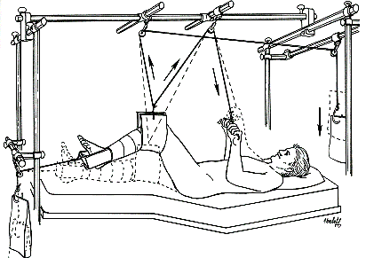
SPLIT RUSSELL TRACTION

Slide 21
BRYANT TRACTION
Useful in treatment of femoral shaft fractures in children
It combines Gallows and Bucks traction
The mattress is raised for counter-traction
Currently not commonly used
It is a skin traction

Slide 22
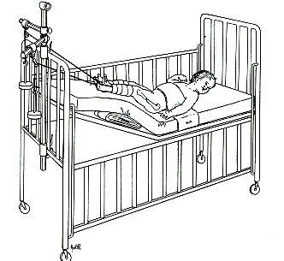
BRYANT TRACTION

Slide 23
DUNLOP TRACTION
Used for supracondylar fractures of humerus in children
It is used when reduction is difficult or traumatic
The elbow is flexed at around 45 degrees
There is a forearm skin traction with a weight suspended on the upper arm

Slide 24
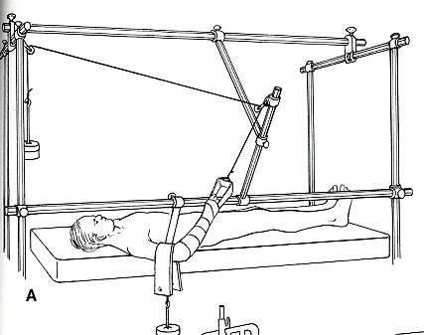
Dunlop traction

Slide 25
CALCANEAL TRACTION
Temporary traction for tibial shaft fracture or calcaneal fracture
Insert about 1.5 inches inferior and posterior to medial malleolus
Do not skewer subtalar joint or Neurovascular bundle by adhering to guidelines for pin insertion at cacaneum
Maintain slight elevation of the leg

Slide 26
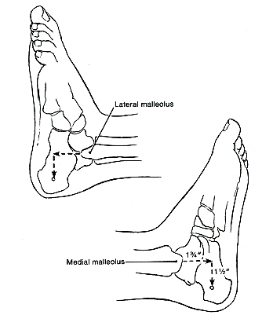
Calcaneal Traction Pin insertion point

Slide 27
PELVIC TRACTION
What are the indications for pelvic traction?

Slide 28
HAMMOCK TRACTION
What is the indications for Hammock traction?

Slide 29
90:90 TRACTION
Useful for sub-trochanteric and proximal 3rd femur fractures
Especially in young children
It matches flexion of proximal fragment
Can cause flexion contracture in adult

Slide 30
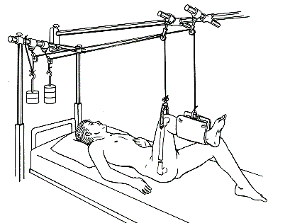
90:90 TRACTION – HOW IT LOOKS

Slide 31
LATERAL OLECRANON PIN TRACTION
Used for humeral fractures
Arm held in moderate abduction
Forearm in skin traction
Excessive weight will distract fracture

Slide 32
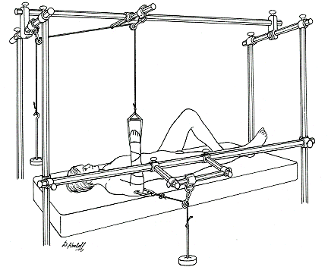
Lateral Olecranon pin Traction

Slide 33
OLECRANON PIN TRACTION
Difficult supracondylar and distal humerus fractures
Greater traction forces are allowed than in case of skin traction
Can make angular and rotational corrections
Place pin 1.25 inches (3cms)distal to tip of the ulnar … this avoids the joint and an open epiphysis
Avoid the ulnar nerve by approach from medial side and make sure to insert the K-wire at right angles to the ulnar

Slide 34
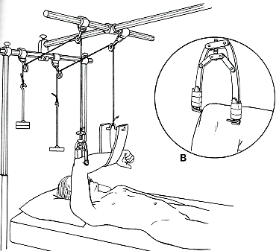
Olecranon Pin Traction

Slide 35
METACARPAL PIN TRACTION
Used for obtaining difficult reduction of distal radius fractures
Once reduction obtained, pins can be incorporated in a plaster cast
Pin placed radial to ulnar through base of 2nd3rd Metacarpal
Stiffness is common

Slide 36
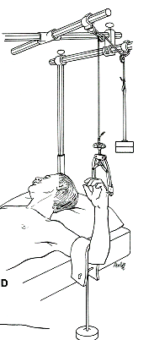
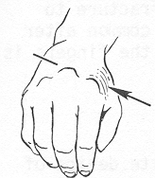
Metacarpal Pin Traction

Slide 37
PERKINS TRACTION
Under LA and aseptic techniques a Denham pin is inserted from lateral side to avoid the common peroneal nerve.
Treatment of fractures of the tibia and the femur distal to the sub-trochanteric region.
Basis is to utilize skeletal traction coupled with active movements
Early muscular activity prevents development of stiffness of joints

Slide 38
Perkins Traction
Bohlers stirrup is applied to the Denham pin and a traction cord is connected to the stirrup
Weights are attached to the traction cord and the foot end of the bed is elevated
A pillow is placed under the thigh to maintain the natural anterior bowing of the femur
The length of the limb is checked with a tape measure adjustment by adding or removing weights

Slide 39
BUCKS TRACTION
Often used preoperatively for femoral fractures
Can use tape or pre-made boot as a component of the traction
No more than 5kilos
Not used to obtain or hold reduction i.e. it is a temporary measure while awaiting for definitive treatment

Slide 40
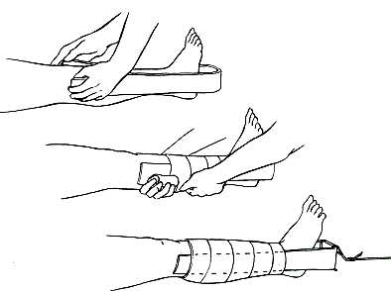
BUCKS TRACTION APPLICATION

Slide 41
DISTAL TIBIAL TRACTION
Useful in certain tibial plateau fractures
Pin inserted 1.25 inches proximal to tip of medial malleolus
Avoid saphenous vein
Place through fibula to avoid peroneal nerve
Maintain partial hip and knee flexion

Slide 42
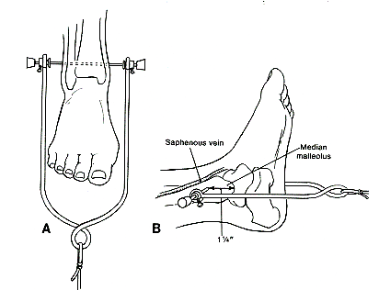
DISTAL TIBIAL TRACTION

Slide 43
PROXIMAL TIBIAL TRACTION
Used for distal 2/3rd femoral shaft fractures
Femoral pin allows rotational moments
Easy to avoid joint and growth plate
1 inch distal and posterior to tibial tubercle

Slide 44
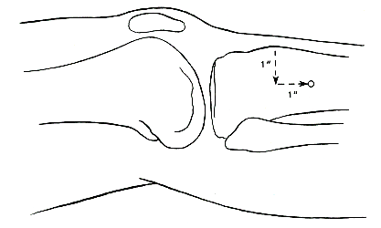
PROXIMAL TIBIAL TRACTION

Slide 45
FEMORAL PIN TRACTION
Must avoid suprapatellar pouch, Neurovascular structures, and growth plate in children
Place just proximal to adductor tubercle along mid-coronal plane
At level of proximal pole of patella in extended position

Slide 46
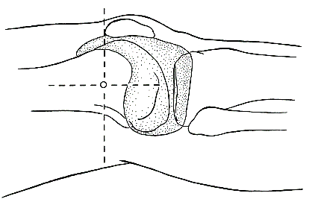
FEMORAL PIN TRACTION

Slide 47
DISTAL FEMORAL TRACTION
Alignment of traction along axis of femur
Used for superior force acetabular fractures and femoral shaft fractures
Used when strong force needed or knee pathology present

Slide 48
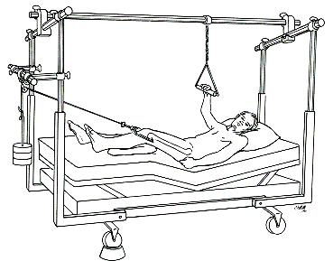
Distal Femoral Traction

Slide 49
UPPER FEMORAL TRACTION
Several traction options for acetabular fractures
Lateral traction for fractures with medial or anterior force
Stretched capsule and ligamentum may reduce acetabular fragments
Not commonly used in our hospitals

Slide 50
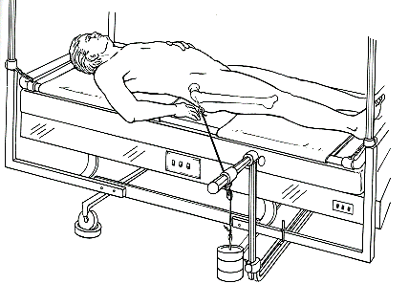
UPPER FEMORAL TRACTION

Slide 51
Balanced Suspension with Pearson Attachment
Enables elevation of limb to correct angular mal-alignment
Counterweighted support system
Four suspension points allow angular and rotational control

Slide 52
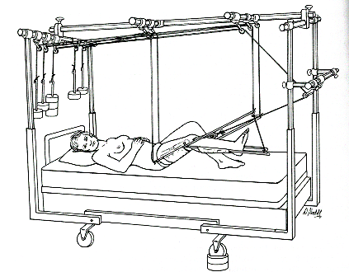
Balanced Suspension with Pearson Attachment

Slide 53
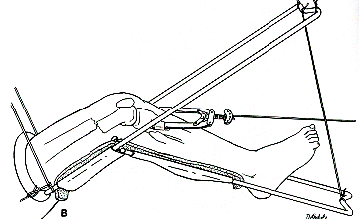
Pearson attachment technique
Distal 3rd fracture has distal fragment flexed posteriorly
Knee should be flexed more sharply
Fulcrum at level fracture
Traction at downward angle
Reduces pull of gastrocnemius

Slide 54
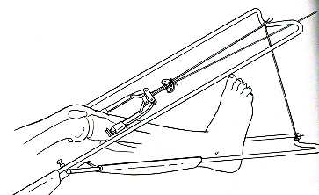
Pearson attachment technique
Middle 3rd fracture had mild flexion of proximal fragment
30 degrees elevation with traction in line with femur

Slide 55
KNOTS USED IN TYING TRACTION CORDS
Ideal knots are easy to tie and untie
Can be tied with one hand while holding the weights
Over hand loop knot will not slip
Slip knot tightens under tension
Sequence is up and over down and over then down and through

Slide 56
TYPES OF KNOTS
Clover hitch
Barrel hitch
Reef knot
Half hitch
2 Half hitches

Slide 57
EXERCISES FOR THE UPPER LIMBS
What exercises can be done for the upper limbs?

Slide 58
EXERCISES FOR THE LOWER LIMBS
What exercises can be done for the lower limbs?

Slide 59
CHARNLEY’S TRACTION UNIT
Below Knee POP incorporating the Steinman or Denham pin
The Common peroneal nerve and calf muscles are protected
External rotation of foot and distal fragment is controlled
Achilles tendon is protected from pressure sores
Ipsilateral tibial fracture can be managed

Slide 60
WEIGHTS
THE AMOUNT OF WEIGHT REQUIRED DEPENDS UPON
1. WEIGHT OF THE APPLIANCE
2. WEIGHT OF THE PART OF THE BODY SUSPENDED IN THE APPLIANCE
3. THE AMOUNT OF FRICTION PRESENT IN THE SYSTEM
4. THE TYPE OF TRACTION BEING USED

Slide 61
PULLEYS
FUNCTION IS TO CONTROL THE DIRECTION OF WEIGHT ATTACHED AT END OF THE CORD OVER THE PULLEY
LARGE PULLEYS OF 6CM DIAMETER AND 6MM DIAMETER OF AXLES IS PREFERRED

Slide 62
FINGER TRAPS
USED FOR DISTAL FOREARM REDUCTIONS
CHANGING FINGERS IMPARTS ULNA /RADIAL ANGULATION
CAN LEAD TO SKIN LOSS OR NECROSIS
RECOMMENDED USE FOR NOT MORE THAN 20 MINUTES

Slide 63
MANAGEMENT OF PATIENTS ON TRACTION
5 CONSIDERATIONS MUST BE MADE
CARE OF THE PATIENT
CARE OF THE TRACTION SYSTEM
RADIOGRAPHIC EXAMINATION
PHYSIOTHERAPY AND
REMOVAL OF TRACTION

Slide 64
CARE OF PATIENT
MUST TAKE CARE OF THE PAIN
CARE OF NUMBNESS OR PARAESTHESIA
CARE OF SKIN IRRITATION
CARE OF SWELLINGS E.G. BY RELEASE OF TIGHT BANDAGES AND ELEVATION
CARE OF WEAKNESS E.G. IN FINGERS, WRIST ETC.

Slide 65
CARE OF TRACTION SYSTEM
MAKE A HABIT OF CHECKING THE TRACTIO SYSTEM PERIODICALLY AND ON ENTERING THE WARD
MAKE SURE OF ITS CONTINUITY
MAKE SURE DIRECTION IS MAINTAINED
MAKE SURE THE WEIGHTS ARE HANGING FREE FROM ANY IMPEDIMENTS
MAKE SURE THERE IS ADEQUATE COUNTERTRACTION
MAKE SURE THE CORDS ARE NOT WORN AND THE KNOTS ARE NOT HELD ON THE PULLEYS

Slide 66
RADIOGRAPHIC EXAM
Radiographic examination best done without moving the patient out of the ward therefore consider portable x-rays
To confirm if traction is adequate do this soon after application of traction
Periodic radiographic examination must be done for good reason to check progress and alignment e.g. After each manipulation and after each weight change

Slide 67
PHYSIOTHERAPY
PHYSIOTHERAPY MUST START AS SOON AS POSSIBLE AND MUST INCLUDE CHEST PHYSIOTHERAPY , UPPER LIMB AND HAND EXERCISES, LOWER LIMB EXERCISES AS PERMITTED BY THE TRACTION SYSTEM AND PROGRESS OF THE PATIENT.

Slide 68
REMOVAL OF TRACTION
WHAT ARE THE REASONS FOR REMOVAL OF TRACTION?

Slide 69
SUCCESS IN YOUR STUDIES
THE END

